Slide 1
Basics in programming

Slide 2
Python modules
Inheritance
In multiple inheritance, the features of all the base classes are inherited into the derived class. The syntax for multiple inheritance is similar to single inheritance.

Slide 3
Python modules
Inheritance

Slide 4
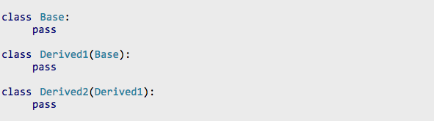
Python modules
Inheritance

Slide 5
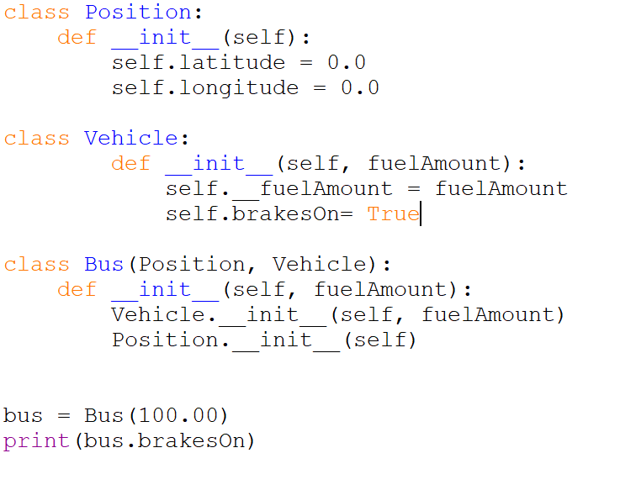
Python modules
Multiple Inheritance
.

Slide 6
Python modules
Polymorphism
The word polymorphism means having many forms. In simple words, we can define polymorphism as the ability of a message to be displayed in more than one form.
Real life example of polymorphism, a person at a same time can have different characteristic. Like a man at a same time is a father, a husband, a employee. So a same person posses have different behavior in different situations. This is called polymorphism.

Slide 7
Python modules
Polymorphism
Suppose, we need to draw a shape, there are multiple shape option (triangle, rectangle, circle). However we could use same method to draw any shape. This concept is called Polymorphism.

Slide 8
Python modules
Polymorphism
Demo by using fruitbox example

Slide 9
Python modules
Overriding the Functionality of a Parent Class
Remember that child classes can also override attributes and behaviors from the parent class.

Slide 10
Python modules
Overriding the Functionality of a Parent Class
Class Dog:
park(self):
print(”vuh vuh”)
class SomeBreed(Dog):
park(self):
print(”hau hau”)

Slide 11
Python modules
Operator overloading
Suppose you have created a Vector class to represent two-dimensional vectors, what happens when you use the plus operator to add them?
You could, however, define the __add__ method in your class to perform vector addition and then the plus operator would behave as per expectation −

Slide 12
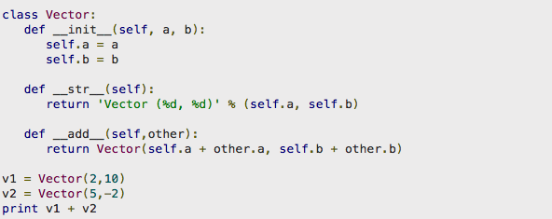
Python modules
Operator overloading

Slide 13
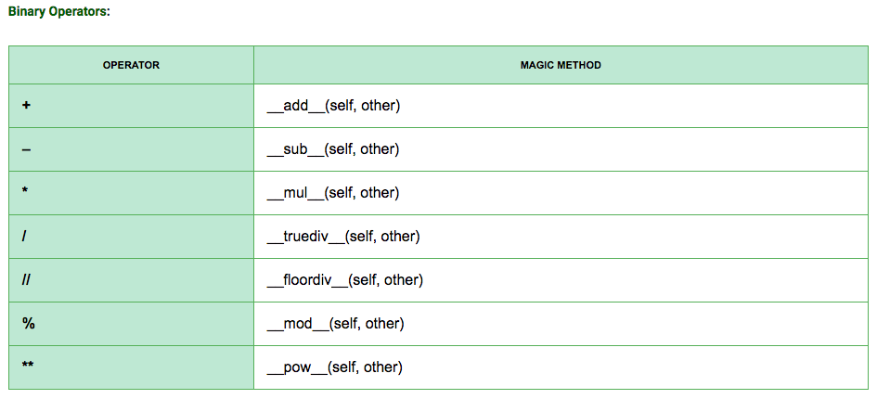
Python modules
Operator overloading

Slide 14
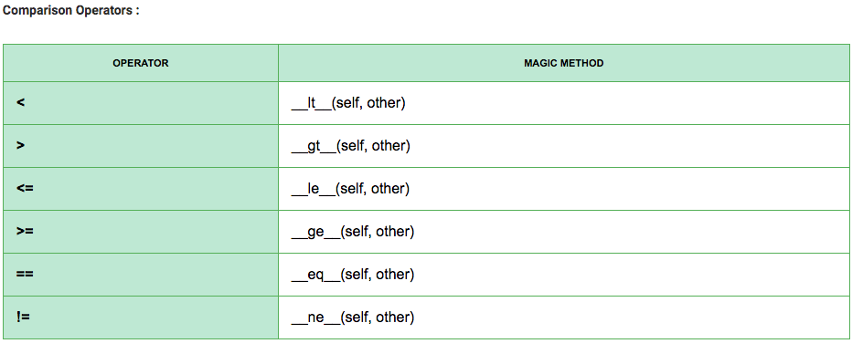
Python modules
Operator overloading

Slide 15
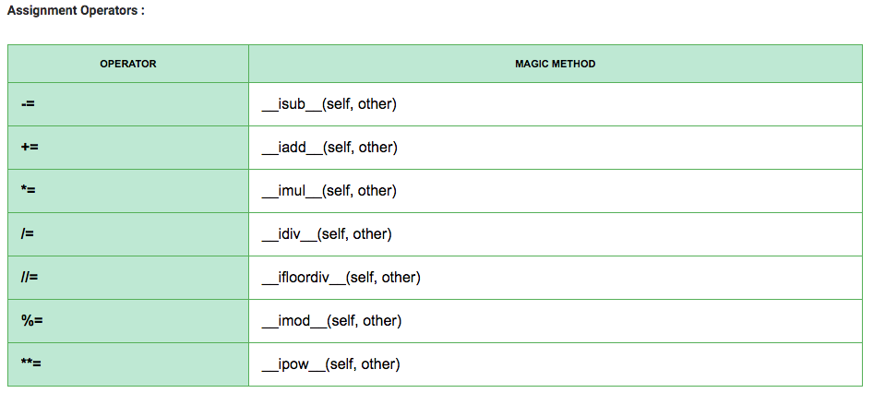
Python modules
Operator overloading

Slide 16
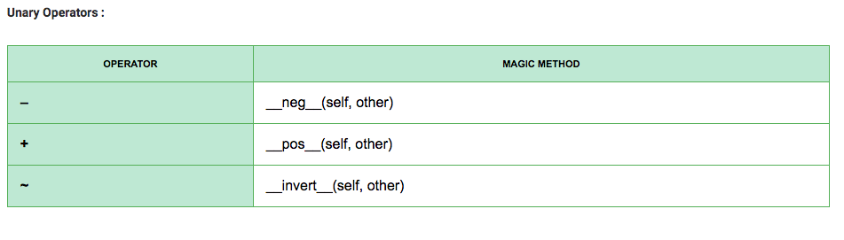
Python modules
Operator overloading

Slide 17
Python modules
Operator overloading
Example: implement subtract, multiplication and division of Vector

Slide 18
Python modules
Operator overloading
Example: implement subtract, multiplication and division of Vector

Slide 19
Python modules
Operator overloading
Example: implement subtract, multiplication and division of Vector

Slide 20
Exercise 13.
Create class called Animal which has class variable count, also create class Mammal which also has class variable count, then create class Human that has two parent classes Animal and Mammal.

